Slide 1
C343 MiniLudu
Paul van Sittert
Stavros Koumpounis

Slide 2
Requirements
Create a MiniLudu game using double linked lists.
4 players moving round a board, with an anticlockwise movement in the outer board, and clockwise in the inner board.
Each player starts in a different location, and follows a slightly different path.
Each player will be given a chance to throw a 4 sided dice to move their piece.
Player landing on other players, who aren’t in a safe zone will take place of the player, and send the other player back to their start.
Players have to land exactly on the centre of the board to win, and three players must win to end the game.

Slide 3
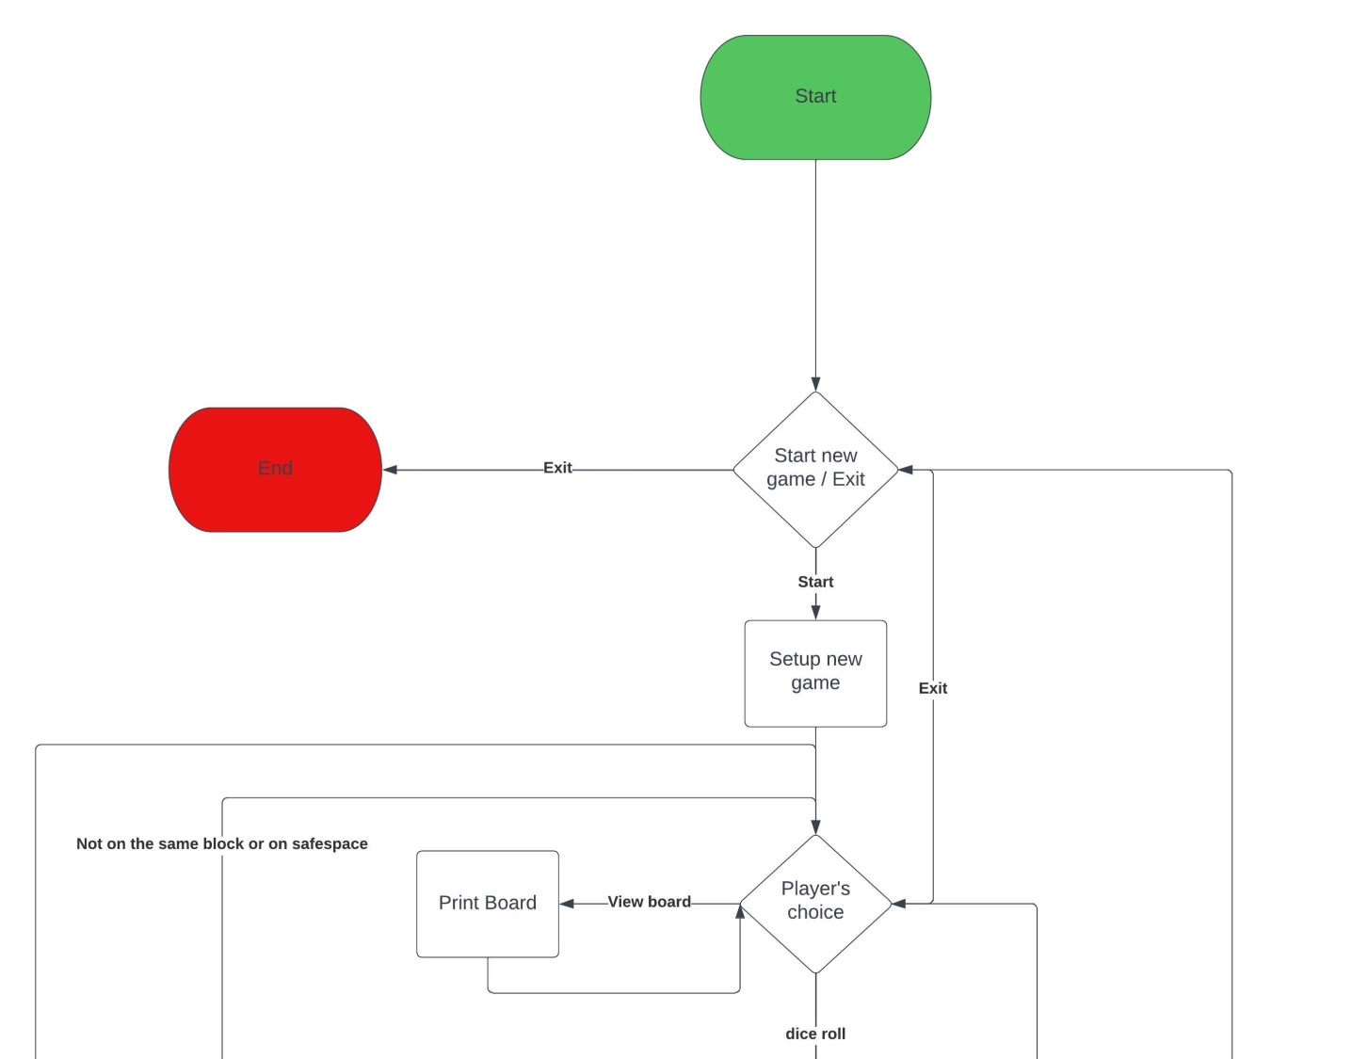
Flowchart

Slide 4

Flowchart

Slide 5
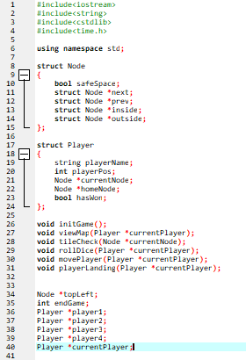
Variables

Slide 6
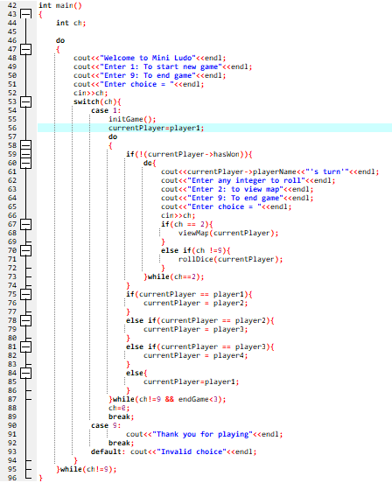
Main

Slide 7
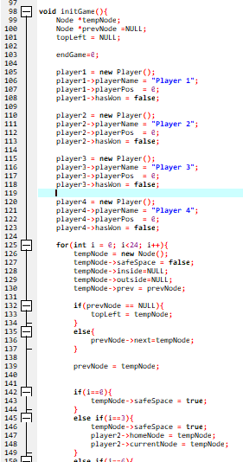
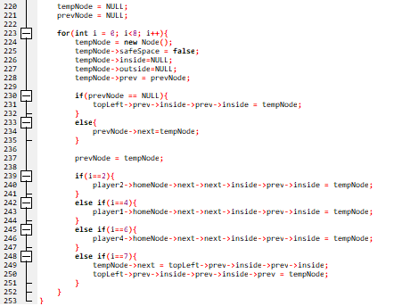
Init

Slide 8
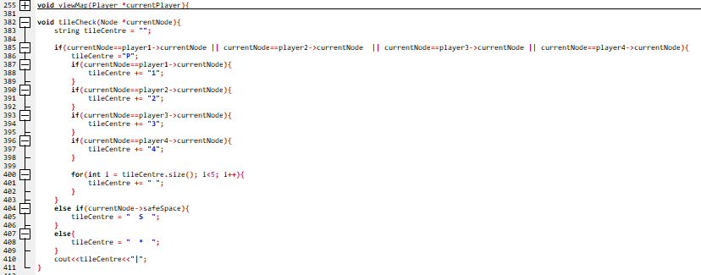
Tile Check

Slide 9
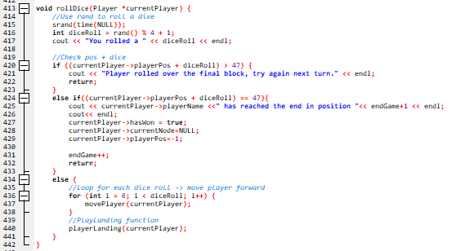
Roll dice

Slide 10
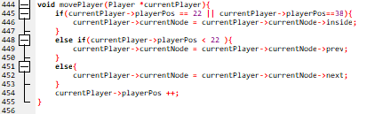
Move player

Slide 11
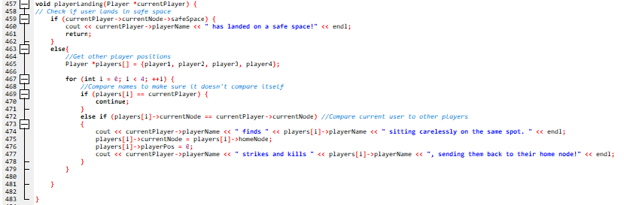
Player Landing

